Slide 1



Lauren Williams
September 2022
Confidential

Slide 2
Introduction to Generic Drug Products + US Market Trends

Slide 3
Generic Pharmaceutical Drug Products
A generic drug has the same active ingredients, route of administration, dosage form, strength and indications to its brand name counterpart – it’s just usually less expensive. This is because Generics are sold after the brand drug patent expires.
Confidential

Slide 4
US Generic Drug Market
US generics have stabilized in the past 24 months… Following a 4-year decline, generic prices are now stabilizing
Source: IMS IQVIA, USFDA Orange Book, Picket
Note: Generic sales value and volume include sales of NDA holders of molecules which have been genericised
Confidential

Slide 5
…Driven by revival in pricing of oral dosage forms Oral dosages account for 65% of the total market followed by inhalants and injectables
Decline in pricing of orals has moderated, driving the overall stabilization of prices
The sharp increase in pricing of inhalants is driven by the 2020 generic approvals for the premium (priced) Albuterol Sulfate Aerosol Inhaler
Excess capacity for topicals has pushed down dermatologicals pricing
Given the injectable capacities currently under construction, we expect pricing to experience a declining trend in the future
Confidential
Source: IMS IQVIA, USFDA Orange Book, Picket
Note: Generic volume by dosage form include sales of NDA holders of molecules which have been genericised.

Slide 6
Increased emphasis on portfolio rationalization Companies are submitting fewer ANDAs, reconsidering launches, and pruning existing launches
Source: IMS IQVIA, USFDA Orange Book, Picket.
Sales lost through discontinuations include sales of the discontinued products in the year prior to discontinuation
Confidential

Slide 7
The market continues to be highly competitive… Larger the product, higher the no. of competitors, and steeper the price decline; 70% of the market has between 3 to 9 competitors
Average no. of competitors relative to product size
70%
Avg. no of competitors
Vol market share %
Average pricing (indexed to 2015)
No of competitors
IMS MAT 2020 product size in USD Mn
Source: IMS IQVIA, USFDA Orange Book, Picket,
1. A product is identified using a combination of molecule, dosage form, and strength 2. A competitor is defined as a distinct parent company that holds an ANDA application for the particular product. 3. This analysis only considers products which have positive sales in both 2015 and 2020
Confidential

Slide 8
…But pockets of opportunities continue to exist Several such opportunities exist in Ophthalmics, Injectables, and Dermatologicals where a sizeable part of the market has 4 or fewer competitors
Break up of 2020 sales by no. of competitors for key dosage forms
No. of competitors:
23% of the market has 4 or fewer competitors
These represent 36 molecule dosage form combinations
9% of the market has 4 or fewer competitors
These represent 248 molecule dosage form combinations
37% of the market has 4 or fewer competitors
These represent 168 molecule dosage form combinations
60% of the market has 4 or fewer competitors
These represent 37 molecule dosage form combinations
16% of the market has 4 or fewer competitors
These represent 8 molecule dosage form combinations
Source: IMS IQVIA, USFDA Orange Book, Picket.
Dosage forms considered include Orals, Injectables, Ophthalmics, Otics, Rectals Systemic, Topical Rectals, Urologicals, Inhalants, Vaginals, Lung, Inserts/Implants, Nasal, Dermatologicals, Mouth & Throat, Other Systemics, Other Topicals, Others..
Only ANDAs considered for this analysis
Picket file reference: T24b

Slide 9
Introduction to Drug Shortages

Slide 10
Drug Shortage Statistics
Drug shortages are an ongoing problem in the US and are typically off-patent, injectable products with few suppliers.
90%
of emergency room doctors routinely lack access to critical medications
(source: American College of Emergency Physicians survey)
56%
of hospitals delayed treatments because of drug shortages
(source: AHA, AH, ASHP survey)
47%
of pharmacists said shortages forced them to use less effective drugs in patient care
(source: Institute for Safe Medication Practices)
Confidential

Slide 11
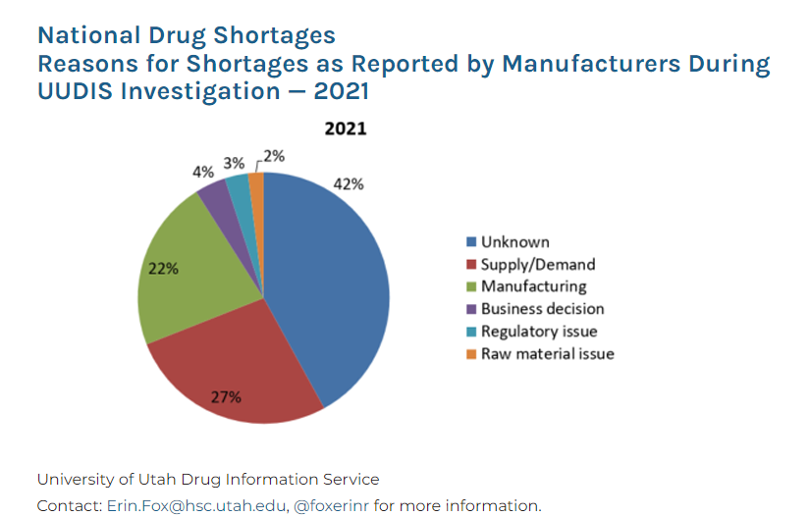
Reasons for Drug Shortages
Drug shortages are largely the result of quality problems during manufacturing, which give rise to a halt in production to address the problem. In the case of a product with few competitors, this disruption in production cannot be absorbed by other companies, and demand outpaces supply, resulting in a shortage. In the case of a sole-source manufacturer, no alternatives for production exist, and clinicians must either struggle to obtain a supply of the drug, compound a drug when possible, or recommend an alternative therapy if one exists.
Confidential

Slide 12
At Picket, we want to…
Use data to gain an understanding of the generic drug market, competition and drug products at risk for shortage.
A good solution will not only help the company, but also directly benefits patients and their access to essential medicines.
Confidential

Slide 13
Other Drug Shortage Resources
ASHP – What You Need to Know About Drug Shortages video: https://www.youtube.com/watch?v=npMJG9DHIBU
ASHP Drug Shortage report: https://www.ashp.org/drug-shortages/shortage-resources/drug-shortages-statistics?loginreturnUrl=SSOCheckOnly
FDA Drug Shortage report: https://www.fda.gov/media/131130/download
ASHP Roundtable Drug Shortage report: https://www.ashp.org/drug-shortages/shortage-resources/roundtable-report
Confidential

Slide 14
Data + Discussion

Slide 15
Dataset and Definitions
Dataset contains generic pharmaceutical drug products with various economic metrics and drug shortage information. Raw dataset was collapsed and grouped by ProductID so there is one row per ProductID. There are 5,231 rows i.e. 5,231 drug products. The sales and units were summed and the medians of the prices across the raw data was taken by ProductID. Notes: (1) “Month0” is the first month of data that we have for a five year period and all other dates are centered around this date. (2) Dataset has been de-identified.
ProductID: (key identifier) 5 digit unique product number, ex: 01742.
Ingredient: Active pharmaceutical ingredient(s) for specific ProductID, ex: Ingredient001.
Form: Dosage form of a specific product, ex: VIAL.
ParentCode: Parent manufacturer code for specific ProductID, ex: OCN.
Strength: Concentration or strength of a specific product, ex: Strength001.
SpecPharm: Specialty pharma or non-specialty pharma. Specialty pharmacies deliver medications with special handling, storage and distribution requirements.
CareClass: Acute or chronic care classification.
DrugClass: Drug classification, ex: PAIN.
ProductLaunchDate: Month of product launch, ex: Month12. If product was launched before Month0 (first month of sales data), then it will have a “_” before the month number which can be interpreted as a negative sign, ex: Month_2 means the product was launched two months before the first month of sales data that we have.
Confidential

Slide 16
Dataset and Definitions Continued
PackSize: number of units per case.
PackQuantity: number of units in one pack.
NDC_Shortage_FL: NDC had at least one shortage during 5 year period (0/1 = shortage (n = 1114)).
StDateX: Start month of shortage #X for a given product, ex: 8.
EnDateX: End month of shortage #X for a given product. Missing end date for a respective start date should be treated as censored data, ex:12.
DurMnthsX: Duration of shortage #X in months (counts). The number “X” indicates the number of shortages that have occurred in the given period, ex: DurMnths2 is the second time that product has gone into shortage.
MonthX_RxSales: Sum of sales for product grouping in month X.
MonthX _Units1: Units (number of packages) summed by product in month X.
MonthX_Units2: Units (bottles/vials) summed by product in month X.
MonthX_Units3: Units (tablets/capsules/mL) summed by product in month X – most granular.
MonthX_WholesalePrice: median wholesale price for product grouping in month X – does not include rebate offered to distributors.
MonthX_ManuPrice: median manufacturer price for product grouping in month X.
MonthX_MjManuCT: Count of major manufacturers by Ingredient and Form in month X.
Confidential

Slide 17
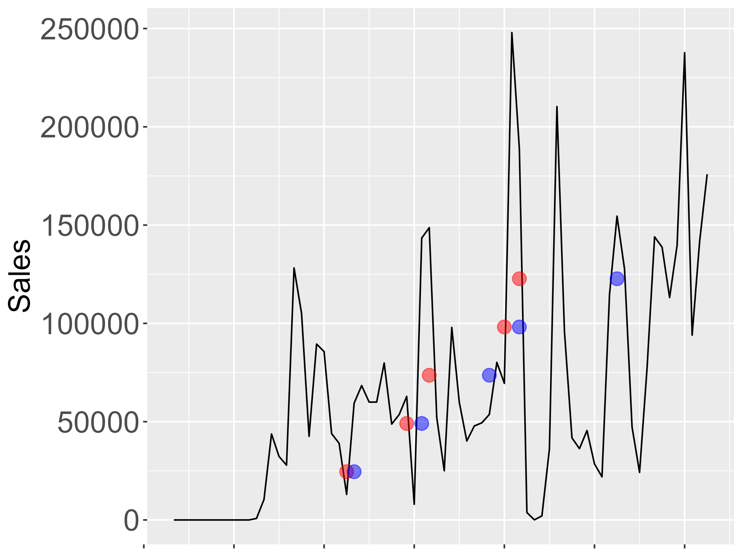
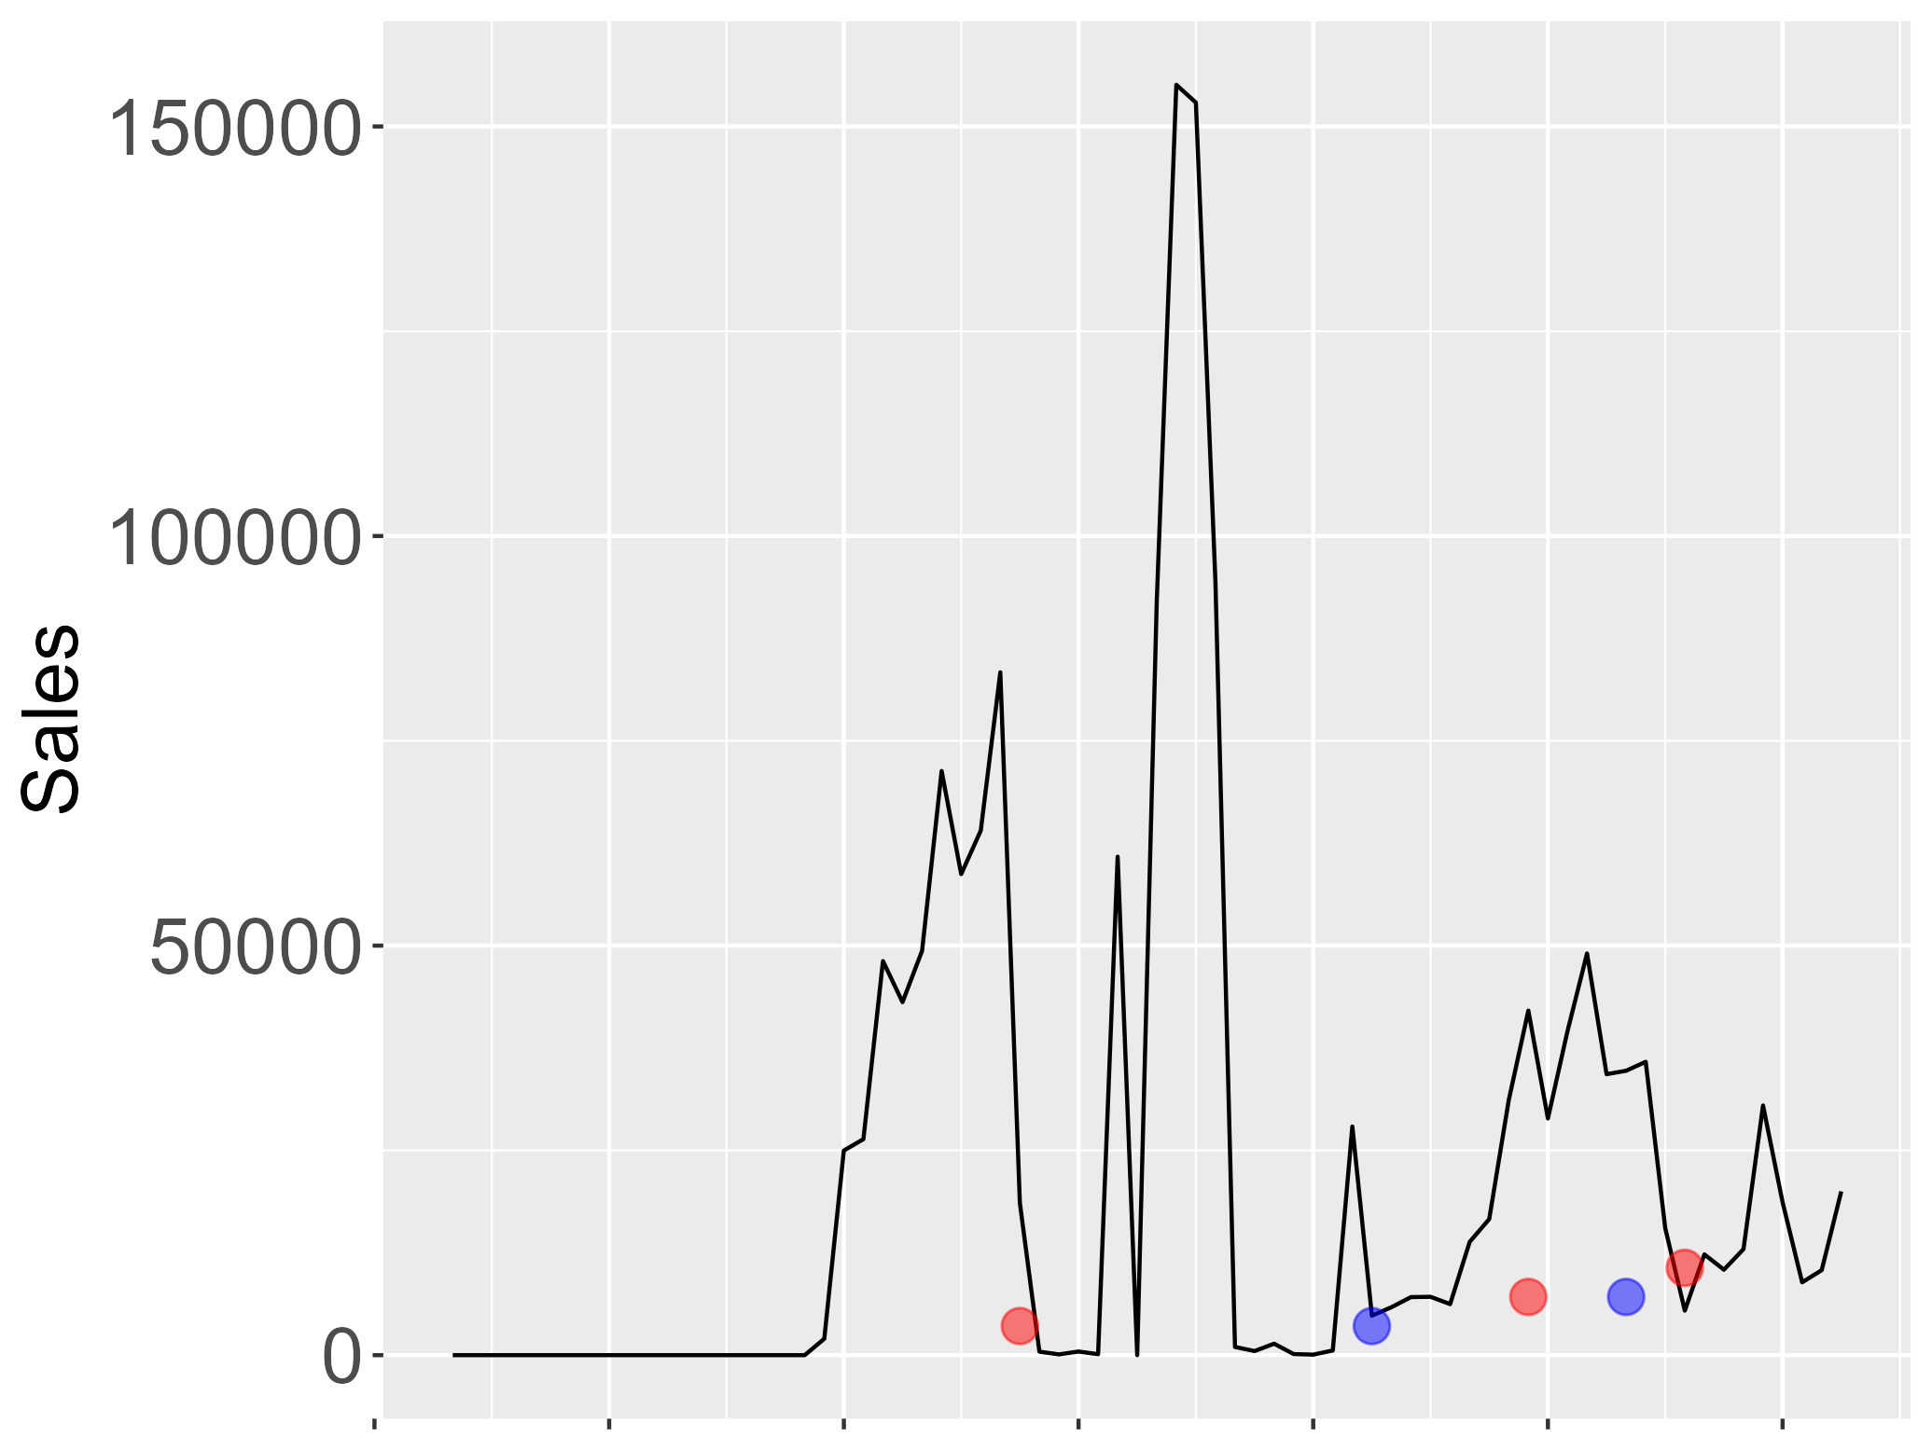
Uploads Available
Dataset (.csv/.xlsx)
Images for shortages and non-shortages for: sales, units1, units2, and units3
Confidential

Slide 18
Class Discussion
What are your initial thoughts on the data provided?
If you were a manufacturer, what techniques would you use to select products? Which products have a high likelihood of going into shortage?
What are some initial questions/problems we can solve with the current data?
What other data do you think would be helpful?
What are some useful exploratory data analysis techniques would you use to start looking at the data?
What trends do you think might show in the data?
What smoothing could we apply to the data to reduce noise?
Inter-variance and intra-variance in corporations? Ingredients? Dosage forms?
Logistic regression or other classification algorithms and machine learning to predict/classify shortage/non shortage.
Is there a signal during the shortage period or before? Consider durations of shortages.
Can we accurately forecast/predict a shortage 6-12 months into the future?
Multivariate time series? Survival analysis? Recurrent events analysis?
Confidential

Slide 19
Thank You
Contact information:
lauren@picketpharma.com
(570) 807 9523
Confidential

